Slide 1
Intelligent Monitoring of Engineering Systems
CNC Milling Machine : Material Identification
Group 1

Slide 2
CNC Milling Machine: Material Identification
INTRODUCTION
METHODS
RESULTS & DISCUSSION
CONCLUSIONS
Group 1

Slide 3
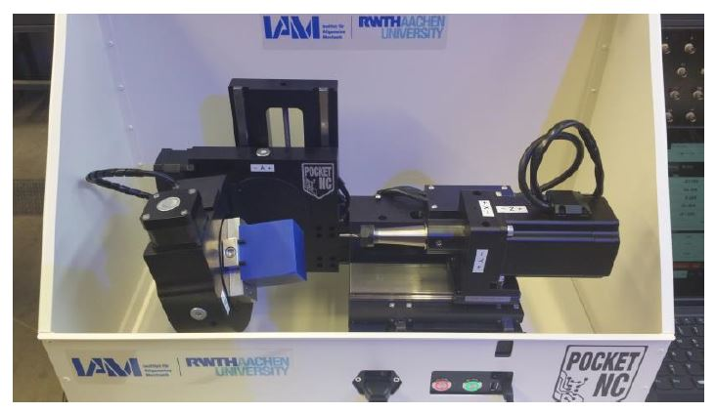
CNC Milling Machine: Material Identification
INTRODUCTION
Goal :
Identification of processed material [wood or plastic]
Analyze the data in time frequency spectrum
Usage of machine learning methods
Given:
Accelerometer & Gyroscope measurements
for wood and plastic during CNC milling
Reference signal for filtering vibrations
Sampling rate of 1600 Hz
Method used :
Supervised learning
Reason: Labelled data
Fig: CNC milling machine
Group 1

Slide 4
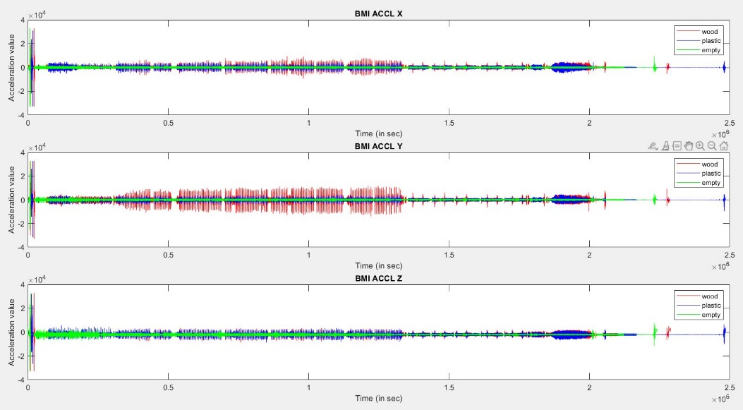
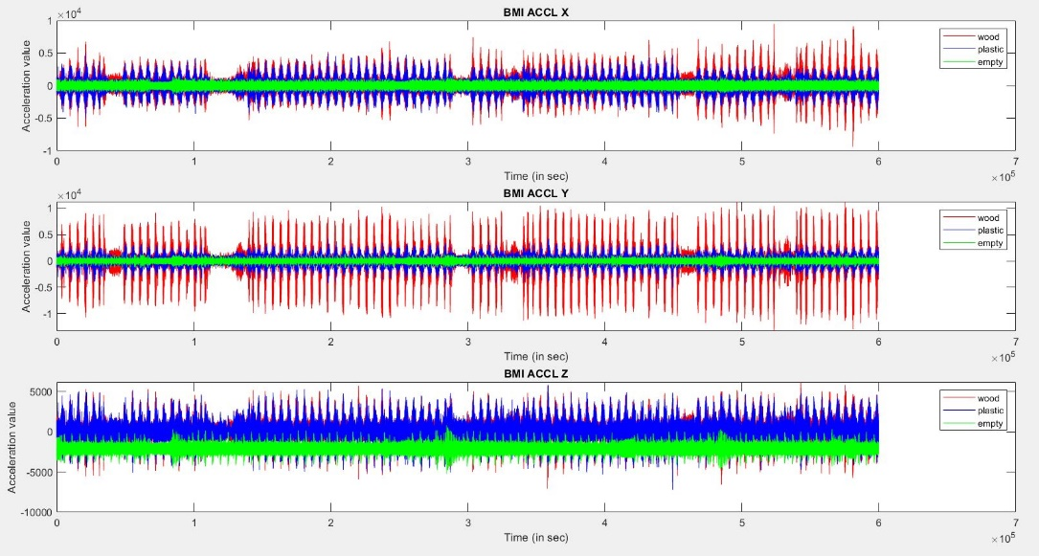
CNC Milling Machine: Material Identification
METHODS
TRIMMING OF RAW DATA:
fig: Representation of raw data (wood, plastic & empty) in time domain
fig: Representation of extracted data (wood, plastic & empty) in time domain
Raw sample data range:
Wood: 0 - 2288544
Plastic: 0 - 2484893
Empty : 0 - 2249655
Extracted sample data range:
Wood, plastic, empty: 300000 - 2000000
Trimmed the initial spikes before 300000
Trimmed the unwanted data after 2000000
Group 1

Slide 5
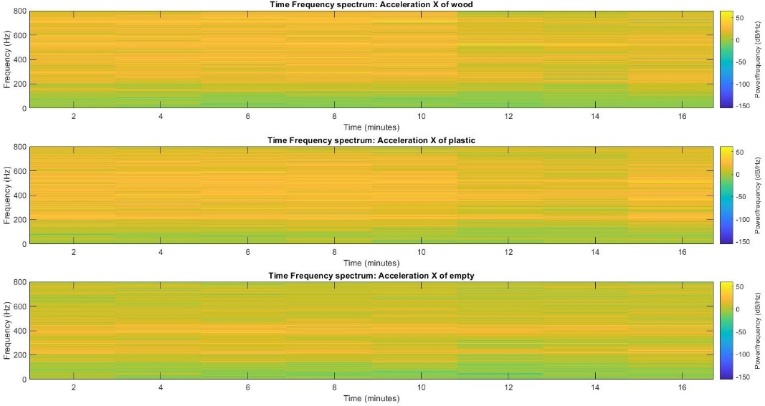
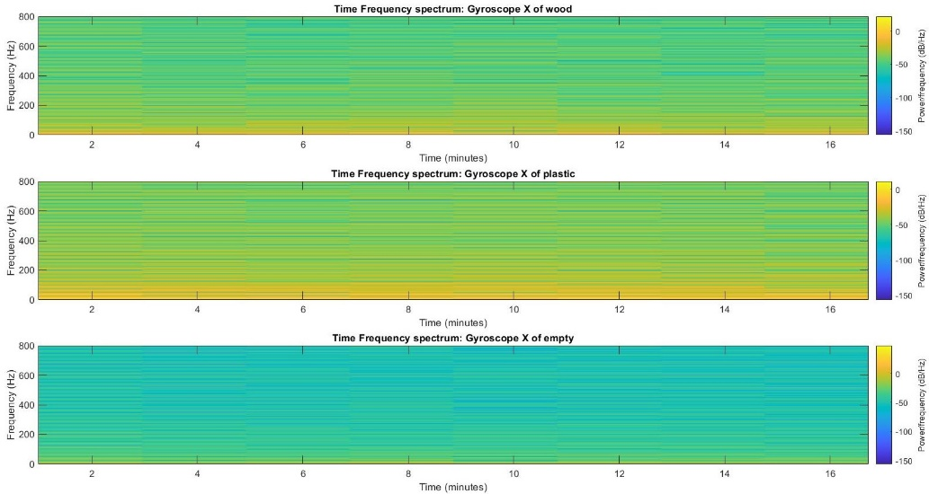
CNC Milling Machine: Material Identification
FILTERING OF DATA
Method used: Low pass filter
Analysis of data in time frequency spectrum for finding the cut-off frequency for filtering
Change in colour pattern after 200 Hz
Cut-off frequency for acceleration: 150 - 200 Hz
Change in colour patter after 20 Hz
Cut-off frequency for gyroscope: 10 - 20 Hz
Group 1

Slide 6
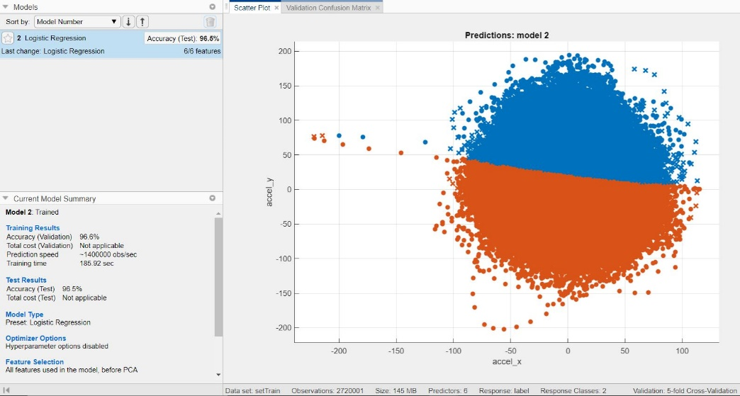
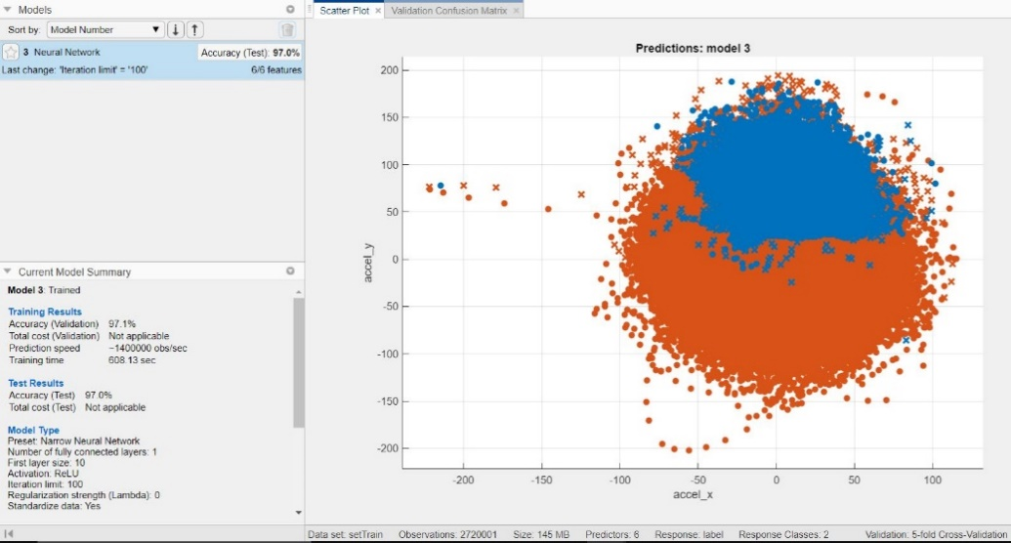
CNC Milling Machine: Material Identification
RESULTS & DISCUSSION
Methods used:
Logistic Regression
Neural Network
Results
Accuracy (Validation): 96.6%
Accuracy (Test): 96.5%
Training Time: 185.92 sec
Results
Accuracy (Validation): 97.1%
Accuracy (Test): 97%
Training Time: 608.13 sec
Group 1

Slide 7
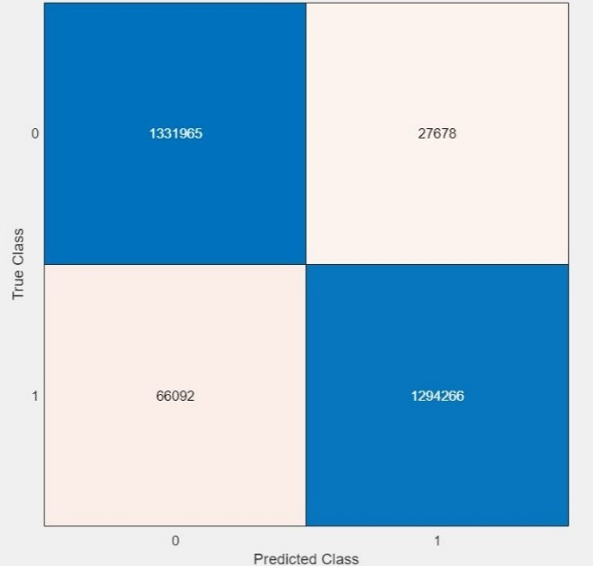
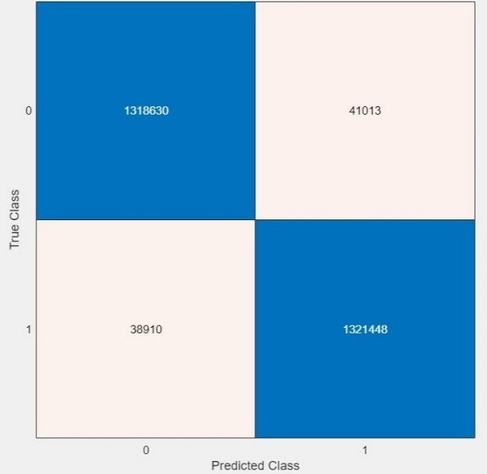
CNC Milling Machine: Material Identification
RESULTS & DISCUSSION
Confusion Matrix:
Logistic Regression
Neural Network
True prediction
of wood
False prediction
of Plastic
True prediction
of wood
False prediction
of Plastic
(95.3%)
(2.1%)
(96.9%)
(2.8%)
False prediction
of plastic
True prediction
of plastic
False prediction
of plastic
True prediction
of plastic
(4.7%)
(97.9%)
(3.1%)
(97.2%)
Group 1

Slide 8
CNC Milling Machine: Material Identification
CONCLUSIONS
Goal: Creating a Machine Learning model to recognize the machined material with the given data sets
Filtering method: low pass, passband frequency of 10 for wood and 200 for plastic and sample rate of 1600 Hz
Method 1: Logistic Regression
Method 2: Neural Networks (Narrow)
Logistics Regression:
Accuracy (Test) - 96.5%
Training Time- 180 seconds
Neural Networks:
Accuracy (Test) - 97%
Training Time- 650 seconds
Neural networks takes 5 times the duration to provide only 0.5% increase in accuracy. Recommended method for time constraints - Logistics Regression
For a given data set, the selected model can predict the material to an accuracy of 96.5%.
Group 1

Slide 9
Thank you for your attention!
Group 1

